Slide 1
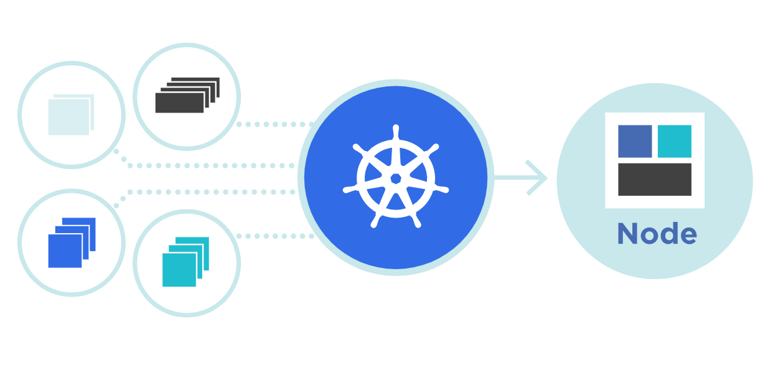




service
Theory + LAB + Documents ➔ All free
WATCH NOW
Notes:
Hello everyone. My name is Anish Rana and you are watching Kubernetes web series.

Slide 2
Agenda of this video.
Need for service?
What is Service?
Type of services?
Installation of Metlab LB.
Lab & Exam preparation.

Slide 3
01 NOW WE WILL TALK ABOUT
Need for service?

Slide 4
Master
Workernode1
Workernode2
Laptop → Window OS

Slide 5
kubectl create deployment test1 --image=nginx --replicas=3
Master
Workernode1
Workernode2
Laptop → Window OS

Slide 6



Deployment
ReplicaSet 1

Slide 7
[root@master1 ~]# kubectl get pods -o wide
NAME READY STATUS RESTARTS AGE IP NODE
test1-7d76cfc454-4x9rd 1/1 Running 0 15m 172.16.14.111 workernode2.example.com
test1-7d76cfc454-hwb2z 1/1 Running 0 15m 172.16.14.112 workernode2.example.com
test1-7d76cfc454-nb4qr 1/1 Running 0 15m 172.16.133.129 workernode1.example.com
[root@master1 ~]# curl -s http://172.16.14.111
<!DOCTYPE html>
<html>
<head>
<title>Welcome to nginx!</title>
<style>
html { color-scheme: light dark; }
body { width: 35em; margin: 0 auto;
font-family: Tahoma, Verdana, Arial, sans-serif; }
</style>
</head>
<body>
<h1>Welcome to nginx!</h1>
<p>If you see this page, the nginx web server is successfully installed and
working. Further configuration is required.</p>
<p>For online documentation and support please refer to
<a href="http://nginx.org/">nginx.org</a>.<br/>
Commercial support is available at
<a href="http://nginx.com/">nginx.com</a>.</p>
<p><em>Thank you for using nginx.</em></p>
</body>
</html>

Slide 8
172.16.14.113
172.16.14.111
Deployment
ReplicaSet 1

Slide 9
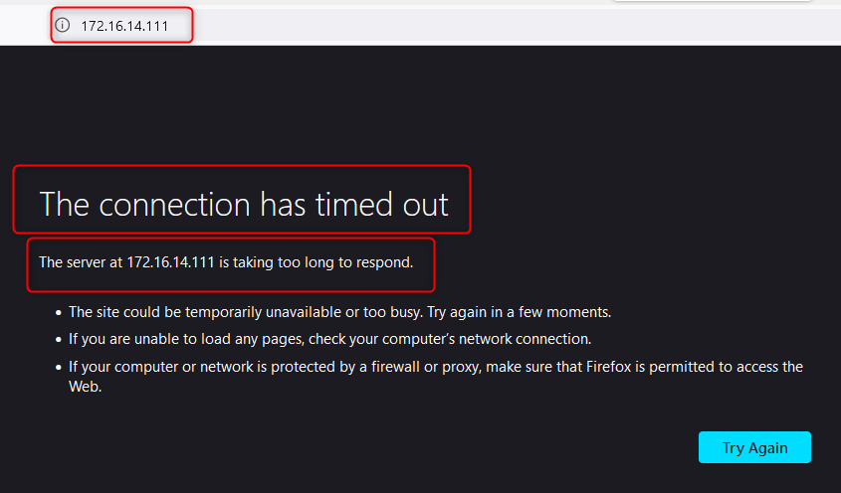
My Laptop browser

Slide 10
The need for services arises from the fact that pods in Kubernetes are short lived and can be replaced at any time.
Kubernetes guarantees the availability of a given pod and replica, but not the liveness of individual pods.
This means that pods that need to communicate with another pod cannot rely on the IP address of the underlying single pod.
Instead, they connect to the service, which relays them to a relevant, currently-running pod.

Slide 11
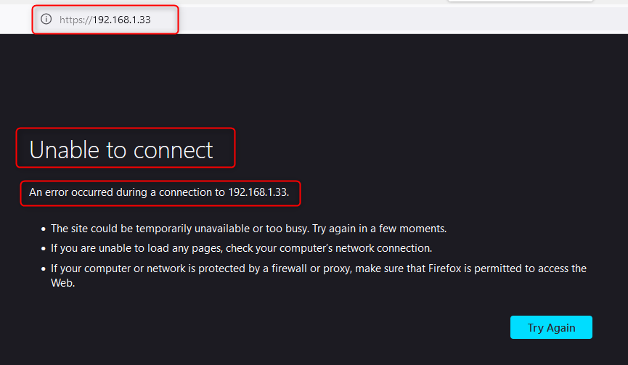
My Laptop browser
[root@workernode2 ~]# ip a l enp0s3
2: enp0s3: <BROADCAST,MULTICAST,UP,LOWER_UP> mtu 1500 qdisc fq_codel state UP group default qlen 1000
link/ether 08:00:27:a2:f9:01 brd ff:ff:ff:ff:ff:ff
inet 192.168.1.33/24 brd 192.168.1.255 scope global dynamic noprefixroute enp0s3
My Laptop browser

Slide 12
Virtual IP
Service-Object
Web-serivce
Deployment
ReplicaSet 1

Slide 13
02 NOW WE WILL TALK ABOUT
What is service?

Slide 14
Service
A Service is a method for exposing a network application that is running as Pod in your cluster.
Whether they are 1 or more than one pods.
Service object defines a logical set of endpoints (usually these endpoints are Pods) along with a policy about how to make those pods accessible.
We need to access the Service Object only.

Slide 15
01 NOW WE WILL TALK ABOUT
Type of services?

Slide 16
Exposes a service which is only accessible from within the cluster.
Exposes a service via a static port on each node’s IP.
Exposes the service via the cloud provider’s load balancer.
Maps a service to a predefined externalName field by returning a value for the CNAME record.
ClusterIP
NodePort
LoadBalancer
ExternalName

Slide 17
ClusterIP
ClusterIP is the default and most common service type.
Kubernetes will assign a cluster-internal IP address to ClusterIP service.
This makes the service only reachable within the cluster.
You cannot make requests to service (pods) from outside the cluster.
A service uses labels and selectors to match pods with other applications.

Slide 18
How to create ClusterIP
From Yaml file

Slide 19
apiVersion: v1
kind: Service
metadata:
name: my-service
namespace: fubar
spec:
selector:
app: test1
ports:
- protocol: TCP
port: 80
targetPort: 80
apiVersion: apps/v1
kind: Deployment
metadata:
name: nginx-deployment
labels:
app: test1
spec:
replicas: 3
selector:
matchLabels:
app: test1
template:
metadata:
labels:
app: test1
spec:
containers:
- name: nginx
image: nginx:1.14.2
ports:
- containerPort: 80
Both values must be equal then only these pods will be selected by ReplicationController

Slide 20
apiVersion: v1
kind: Service
metadata:
name: my-service
namespace: fubar
spec:
type: ClusterIP
selector:
app: test1
ports:
- protocol: TCP
port: 80
targetPort: 80
apiVersion: apps/v1
kind: Deployment
metadata:
name: nginx-deployment
labels:
app: test1
spec:
replicas: 3
selector:
matchLabels:
app: test1
template:
metadata:
labels:
app: test1
spec:
containers:
- name: nginx
image: nginx:1.14.2
ports:
- containerPort: 80
Both values must be equal then only these pods will be selected by ReplicationController

Slide 21

How to create ClusterIP
From Yaml file
From command line

Slide 22
kubectl -n fubar create service clusterip my-cs --tcp=80:80
kubectl edit -n fubar service/my-cs
kubectl -n fubar get endpoints/my-cs
NAME ENDPOINTS AGE
my-cs 172.16.14.11:80,172.16.14.112:80,172.16.133.129:80 71s

Slide 23
[root@master1 ~]# kubectl -n fubar create deployment test2-deploy --image=nginx
deployment.apps/test2-deploy created
[root@master1 ~]# kubectl -n fubar expose deployment test2-deploy --port=80 --target-port=80 --protocol=TCP
service/test2-deploy exposed
[root@master1 ~]# kubectl -n fubar get all
NAME READY STATUS RESTARTS AGE
pod/test1-7d76cfc454-4vxfk 1/1 Running 0 6h36m
pod/test1-7d76cfc454-c9vtr 1/1 Running 1 (6h38m ago) 17h
pod/test1-7d76cfc454-wmkr8 1/1 Running 1 (6h38m ago) 17h
pod/test2-deploy-7ff89c8d85-bqgl9 1/1 Running 0 36s
NAME TYPE CLUSTER-IP EXTERNAL-IP PORT(S) AGE
service/my-cs ClusterIP 10.103.0.191 <none> 80/TCP 17h
service/my-service ClusterIP 10.107.4.233 <none> 80/TCP 18h
service/test2-deploy ClusterIP 10.97.221.134 <none> 80/TCP 8s
NAME READY UP-TO-DATE AVAILABLE AGE
deployment.apps/test1 3/3 3 3 18h
deployment.apps/test2-deploy 1/1 1 1 36s
NAME DESIRED CURRENT READY AGE
replicaset.apps/test1-7d76cfc454 3 3 3 18h
replicaset.apps/test2-deploy-7ff89c8d85 1 1 1 36s

Slide 24
How to create ClusterIP
From Yaml file
From command line

Slide 25
Another, less popular option is to create a service without a pod selector.
This lets you point a service to another namespace, or another service in the cluster, or a static IP outside the cluster.

Slide 26
Exposes a service which is only accessible from within the cluster.
Exposes a service via a static port on each node’s IP.
Exposes the service via the cloud provider’s load balancer.
Maps a service to a predefined externalName field by returning a value for the CNAME record.
ClusterIP
NodePort
LoadBalancer
ExternalName

Slide 27
NodePort
NodePort service is an extension of ClusterIP service. When we create a NodePort service, ClusterIP service will create automatically.
It expose the service outside of your cluster (on each node) by adding a static port on the top of ClusterIP.
Each node proxies that static port into your Service. So, external traffic has access to fixed port on each Node.
Kubernetes will automatically assign a static port if we not specify the port number.
Node port must be in the range of 30000–32767.
Requester need to send the request on nodePortIP:staticPort

Slide 28
Master
192.168.1.31
VM/WorkerNode1
VM/WorkerNode2
Service
192.168.1.32:30000
192.168.1.33:30000
Cloud

Slide 29
apiVersion: v1
kind: Service
metadata:
name: my-nodeport-service
namespace: fubar
spec:
type: NodePort
selector:
app: test1
ports:
- protocol: TCP
port: 80
targetPort: 80
nodePort: 30000

Slide 30
[root@master1 ~]# kubectl apply -f my-nodeport-service.yaml
service/my-nodeport-service created
[root@master1 ~]# kubectl -n fubar get service/my-nodeport-service
NAME TYPE CLUSTER-IP EXTERNAL-IP PORT(S) AGE
my-nodeport-service NodePort 10.96.4.221 <none> 80:30000/TCP 21s
[root@master1 ~]# kubectl -n fubar get endpoints/my-nodeport-service
NAME ENDPOINTS AGE
my-nodeport-service 172.16.133.130:80,172.16.133.131:80,172.16.133.134:80 34s
[root@master1 ~]# curl http://10.96.4.221
<!DOCTYPE html>
<html>
<head>
<title>Welcome to nginx!</title>
<style>
html { color-scheme: light dark; }
body { width: 35em; margin: 0 auto;

Slide 31
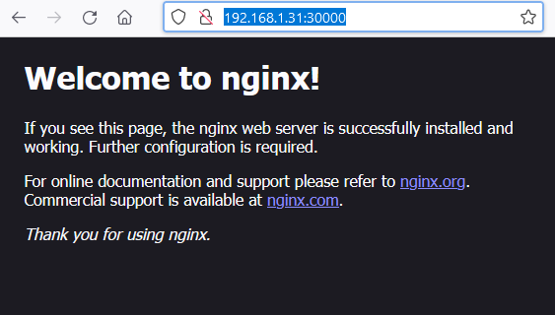
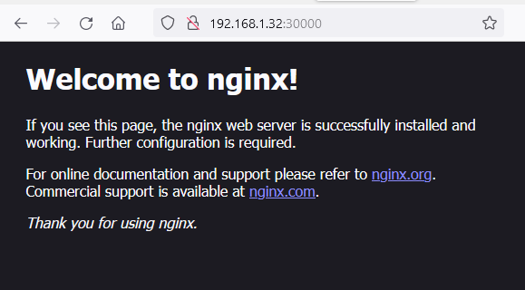

[root@master1 ~]# cat /etc/hosts
127.0.0.1 localhost localhost.localdomain localhost4 localhost4.localdomain4
::1 localhost localhost.localdomain localhost6 localhost6.localdomain6
192.168.1.31 master1
192.168.1.32 workernode1
192.168.1.33 workernode2

Slide 32
[root@master1 ~]# kubectl -n fubar describe service/my-nodeport-service
Name: my-nodeport-service
Namespace: fubar
Labels: <none>
Annotations: <none>
Selector: app=test1
Type: NodePort
IP Family Policy: SingleStack
IP Families: IPv4
IP: 10.96.4.221
IPs: 10.96.4.221
Port: <unset> 80/TCP
TargetPort: 80/TCP
NodePort: <unset> 30000/TCP
Endpoints: 172.16.133.130:80,172.16.133.131:80,172.16.133.134:80
Session Affinity: None
External Traffic Policy: Cluster
Events: <none>

Slide 33
[root@master1 ~]# kubectl create namespace kdp1003
namespace/kdp1003 created
[root@master1 ~]# kubectl -n kdp1003 create deployment test1-deploy --image=nginx
deployment.apps/test1-deploy created
[root@master1 ~]# kubectl -n kdp1003 expose deployment test1-deploy --name=test1-deploy-svc --port=80 --target-port=80 --protocol=TCP --type=NodePort
service/test1-deploy-svc exposed
[root@master1 ~]# kubectl -n kdp1003 get all
NAME READY STATUS RESTARTS AGE
pod/test1-deploy-6d8b567b96-sqvl4 1/1 Running 0 2m48s
NAME TYPE CLUSTER-IP EXTERNAL-IP PORT(S) AGE
service/test1-deploy-svc NodePort 10.98.2.196 <none> 80:31606/TCP 12s
NAME READY UP-TO-DATE AVAILABLE AGE
deployment.apps/test1-deploy 1/1 1 1 2m48s
NAME DESIRED CURRENT READY AGE
replicaset.apps/test1-deploy-6d8b567b96 1 1 1 2m48s

Slide 34
Exposes a service which is only accessible from within the cluster.
Exposes a service via a static port on each node’s IP.
Exposes the service via the cloud provider’s load balancer.
Maps a service to a predefined externalName field by returning a value for the CNAME record.
ClusterIP
NodePort
LoadBalancer
ExternalName

Slide 35
LoadBalancer service is an extension of NodePort service. When we create LoadBalancer service, not only nodePort and ClusterIP service will create but also their routes will be created.
It exposes the Service externally using a cloud provider’s load balancer. It means that in order to integrate external loadbalancer, we have to create this service.
Each cloud provider (Azure, GCP, AWS, etc) has its own native load balancer implementation. The cloud provider will create a load balancer, which then automatically routes traffic to your Kubernetes Service.
External LoadBalancer will route the traffic to our PODs through LoadBalancer service.
For exposing the deployment, we have to create a new LoadBalancer service and get the IP from the external LoadBalancer.

Slide 36
apiVersion: v1
kind: Service
metadata:
name: my-lb-service1
namespace: tiger
spec:
type: LoadBalancer
selector:
app: test1-web-deploy
ports:
- protocol: TCP
port: 80
targetPort: 80
nodePort: 30002
Yaml file for LoadBalancer

Slide 37
[root@master1 ~]# kubectl create namespace tiger
namespace/tiger created
[root@master1 ~]# kubectl -n tiger create deployment test1-web-deploy --image=nginx
deployment.apps/test1-web-deploy created
[root@master1 ~]# cat <<EOF>> my-lb-service1.yaml
apiVersion: v1
kind: Service
metadata:
name: my-lb-service1
namespace: tiger
spec:
type: LoadBalancer
selector:
app: test1-web-deploy
ports:
- protocol: TCP
port: 80
targetPort: 80
nodePort: 30002
EOF
[root@master1 ~]# kubectl create -f my-lb-service1.yaml
service/my-lb-service1 created

Slide 38
[root@master1 ~]# kubectl -n tiger get service/my-lb-service1
NAME TYPE CLUSTER-IP EXTERNAL-IP PORT(S) AGE
my-lb-service1 LoadBalancer 10.109.234.155 <pending> 80:30002/TCP 6m29s
[root@master1 ~]# kubectl -n tiger get endpoints/my-lb-service1
NAME ENDPOINTS AGE
my-lb-service1 172.16.14.123:80 6m21s
[root@master1 ~]# kubectl get pods --show-labels -n tiger
NAME READY STATUS RESTARTS AGE LABELS
test1-web-deploy-5ff564c787-mmftp 1/1 Running 0 9m19s app=test1-web-deploy,pod-template-hash=221

Slide 39
[root@master1 ~]# kubectl -n tiger describe service/my-lb-service1
Name: my-lb-service1
Namespace: tiger
Labels: <none>
Annotations: <none>
Selector: app=test1-web-deploy
Type: LoadBalancer
IP Family Policy: SingleStack
IP Families: IPv4
IP: 10.109.234.155
IPs: 10.109.234.155
Port: <unset> 80/TCP
TargetPort: 80/TCP
NodePort: <unset> 30002/TCP
Endpoints: 172.16.14.123:80
Session Affinity: None
External Traffic Policy: Cluster
Events: <none>

Slide 40
kubectl apply -f https://raw.githubusercontent.com/metallb/metallb/v0.13.9/config/manifests/metallb-native.yaml
cat <<EOF>> IPAddressPool.yaml
apiVersion: metallb.io/v1beta1
kind: IPAddressPool
metadata:
name: first-pool
namespace: metallb-system
spec:
addresses:
- 192.168.1.100-192.168.1.110
EOF
ip a s
[root@master1 ~]# kubectl create -f ipaddresspool.yaml
ipaddresspool.metallb.io/first-pool created
[root@master1 ~]# kubectl -n tiger get service/my-lb-service1
NAME TYPE CLUSTER-IP EXTERNAL-IP PORT(S) AGE
my-lb-service1 LoadBalancer 10.109.234.155 192.168.1.100 80:30002/TCP 28m

Slide 41
Exposes a service which is only accessible from within the cluster.
Exposes a service via a static port on each node’s IP.
Exposes the service via the cloud provider’s load balancer.
Maps a service to a predefined externalName field by
returning a value for the CNAME record.
ClusterIP
NodePort
LoadBalancer
ExternalName

Slide 42
In Kubernetes, an ExternalName service is a way to create a DNS CNAME record that points to an external service outside of the cluster.
It can use the ExternalName service to resolve the DNS name of the external service.
The ExternalName service acts as a bridge between the Kubernetes cluster and the external service, allowing pods to communicate with external services using a Kubernetes-style DNS name.
The ExternalName service is implemented as a headless service with a single endpoint.

Slide 43
The ExternalName service can be useful in situations where you need to access an external service from within the cluster, but you don't want to hardcode the IP address or DNS name of the external service in your application.

Slide 44
apiVersion: v1
kind: Service
metadata:
name: my-external-service
spec:
type: ExternalName
externalName: mydatabase.example.com

Slide 45
11 NOW WE WILL TALK ABOUT
LAB + Exam preparation

Slide 46
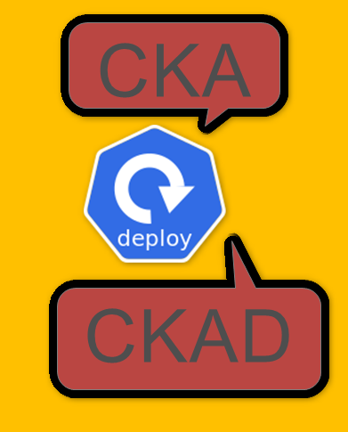
kubectl get deploy
kubectl get deployment nginx-deployment
kubectl get deployment nginx-deployment -n core
kubectl get rs
kubectl describe deployment nginx-deployment
kubectl apply -f https://k8s.io/examples/controllers/nginx-deployment.yaml
Kubectl create deployment nginx --image=nginx:1.14.2
kubectl set image deployment nginx-deployment nginx=nginx:1.16.1
kubectl edit deployments.apps nginx-deployment
kubectl rollout undo deployment/nginx-deployment

